Slide 1

WAN Automation Framework
Infrastructure Resiliency & Deployment Orchestration TechLink Solutions

Slide 2

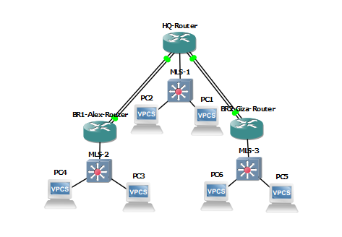

NETWORK TOPOLOGY OVERVIEW
Architecture Design
Strategic multi-branch layout connecting Cairo HQ to Alexandria and Giza regional nodes.
•
Dual WAN Ingress: Redundant ISP paths per branch terminating on Core L3.
•
Path Separation: HQ Core isolates transit traffic from campus L2 domains.
•
High Availability: Physical diversity across Gi1/0 to Gi4/0 interfaces.
Logical Segmentation: Strict separation of the management plane (VLAN 10) from end-user traffic (VLAN 20) across all local access ports

Slide 3
IP STRATEGIC ADDRESSING
Segment Role | Prefix | Subnet Mask | Design Rationale
WAN Point-to-Point | 192.168.x.x | 255.255.255.252 (/30) | Conserve space, minimize broadcast noise
Inter-Site Transit | 10.10.1.0 | 255.255.255.252 (/30) | L3 Core to Distribution Handoff
Branch LAN (Users) | 10.11.20.0 | 255.255.255.0 (/24) | Scalable local user segmentation
Branch Management | 10.11.10.0 | 255.255.255.0 (/24) | Isolated OOB management access

Slide 4




DYNAMIC ROUTING ENGINE
OSPF Area 0
Self-Healing
Single Backbone Area 0 configuration for maximum convergence speed and simplicity.
Sub-second RIB recalculation upon link state failure ensures zero-touch recovery.

Slide 5

SWITCHING & SEGMENT ARCHITECTURE
L2/L3 Access Control
Standardized switching templates across all branches for uniform policy enforcement.
•
VLAN 10: Management SVI for device telemetry.
•
VLAN 20: End-user data segment with DHCP relay to Core.
•
Transit: Routed port FE0/0 isolation on Multi-Layer Switches.

Slide 6
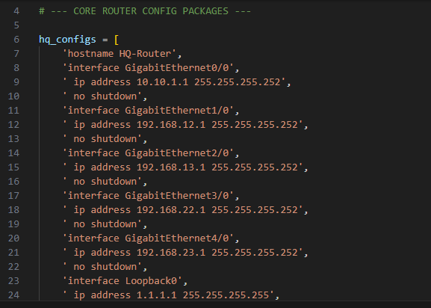
AUTOMATED PROVISIONING
Configuration Deployment Script (initial_deploy.py)
Deployment engine utilizing Python and Netmiko for zero-error baseline configuration.
•
Zero-Touch Provisioning" (Just One Click)
•
Zero Configuration Drift" (Organized)
•
Time/Effort Saved

Slide 7
LIVE MONITORING TELEMETRY
Telemetry Logic
Continuous route table polling provides human-readable status dashboards every 30 secs.

Slide 8




PHASE 2: STRATEGIC ROADMAP
Q3 - 2026
Q4 - 2026
Q1 - 2027
Q2 - 2027
Security hardening: Implement IPsec tunnels over OSPF transit links.
SD-WAN Trial: Introduction of centralized policy management.
Cloud Edge: Direct interconnection to Azure/AWS local zones.
AI Ops: Predictive failure analysis via machine learning telemetry.

